Slide 1
conclusion

Slide 2
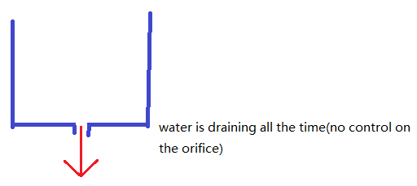
Another plan

Slide 3
To calculated the size of orifice

Slide 4

Using the model equation for the height of fluid in the tank at time t
initial height = max water level = 3 (m)
Final height = min water level = 0 (m) in worst condition
A = pi * 4.6^2
Cd = 0.79

Slide 5
Using the model equation for the height of fluid in the tank at time t
t = 47 days = 4060800(s)
0 = sqrt(3) – a0 * 0.79 / (pi * 4.6^2) * [sqrt(9.8/2)] * 4060800
a0 = 1.621E-5 (m^2) = 0.1621(cm^2)

Slide 6
What about other factors?
Factors…………….that are the same…………………

Slide 7
Thanks for your attention!
Group:
Member:
Xulin Yang,

